Slide 1
Cooking schools/selling food/giving food away guidance
Dr. Ben Chapman
NC State University
August 24, 2017

Slide 2
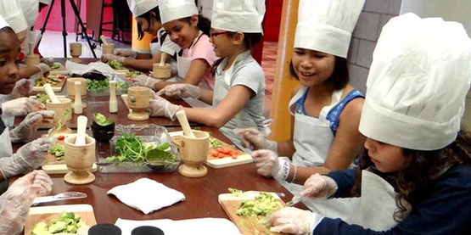
Want to promote more of these types of events, as opposed to fewer, this is where we are providing unique, evidence-based programming that is needed.

Slide 3
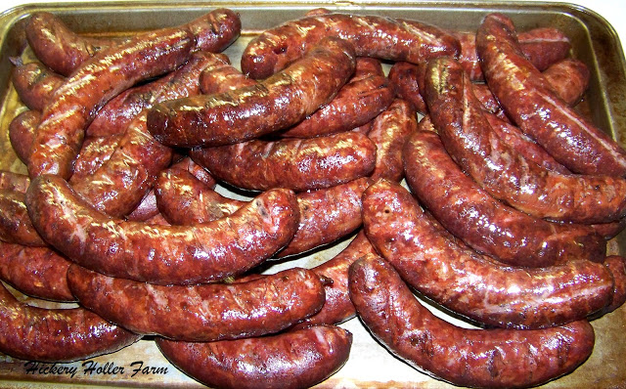
2011 outbreak of Salmonella in MD linked to venison sausage processed by 4-H club. Food products used in pancake breakfast fundraiser

Slide 4
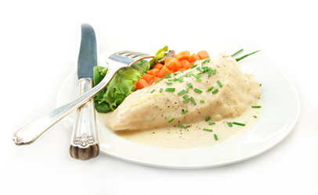
19 ill associated with Alabama Cooperative Extension training for elderly caregivers

Slide 5
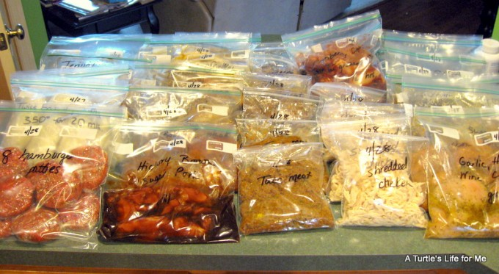
Tell me about your food-related programing
Tell me about your food-related programming?
What types of education events/classes?
What types of other activities?

Slide 6
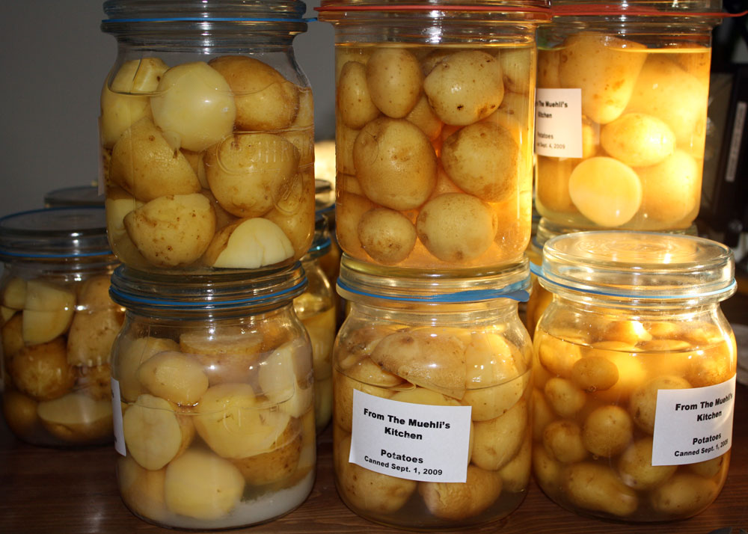
Clostridium botulinum
Lancaster, Ohio
One death and 24 illnesses
Linked to a church potluck
Canned potatoes in potato salad

Slide 7
What is food in commerce or food for pay?

Slide 8
Advertising/words matter
Food in commerce:
“included in your class fee of $25 is a jar of home-canned green beans, a jar of pickles and a jar of jam”
Food not in commerce:
“This class will teach you how to can, samples will be provided”

Slide 9
Advertising/words matter
Food in commerce:
“For $60 you will receive 8 slowcooker freezer meals can you can take home”
Food not in commerce:
“This class will teach you how to shop for, prepare and make freezer meals with a group of friends; samples of the meals will be provided”

Slide 10
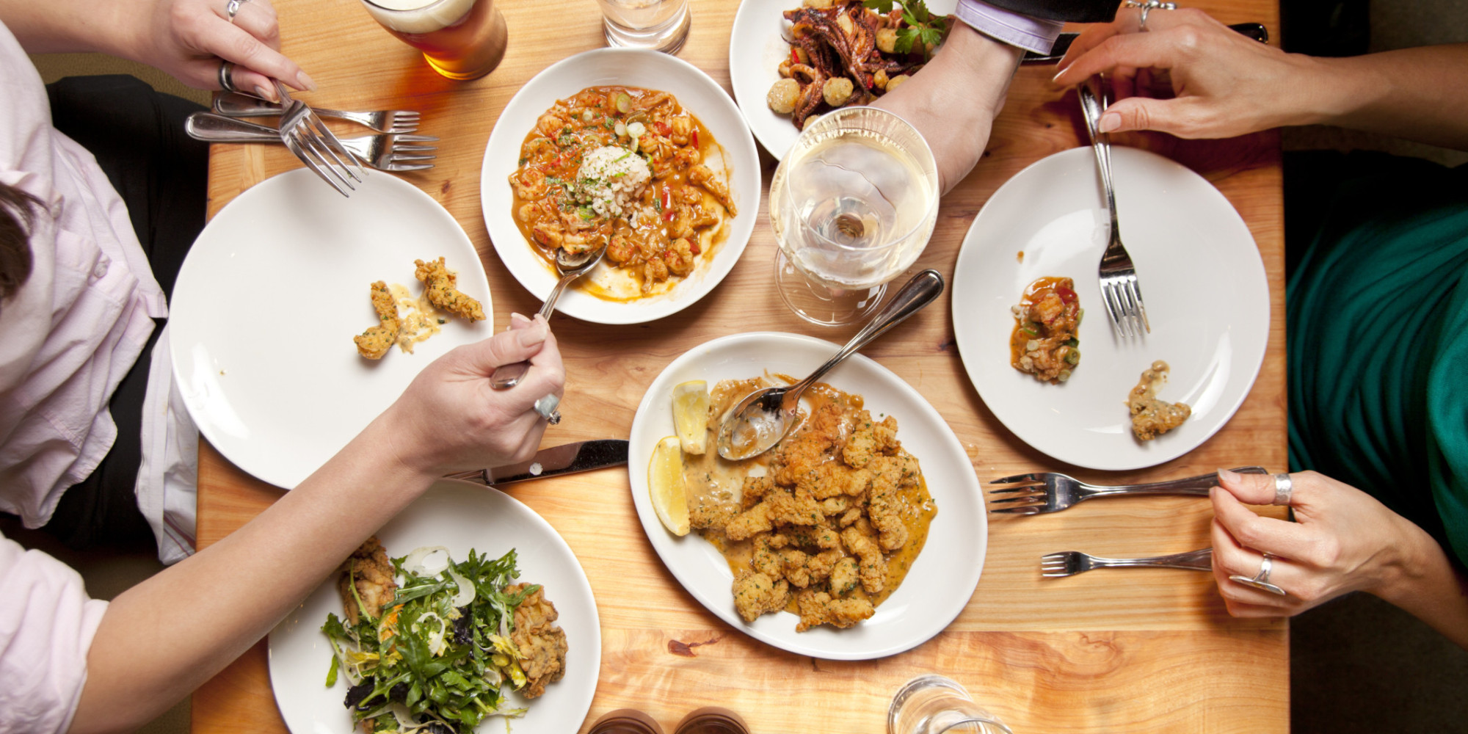
Who regulates this type of business?

Slide 11
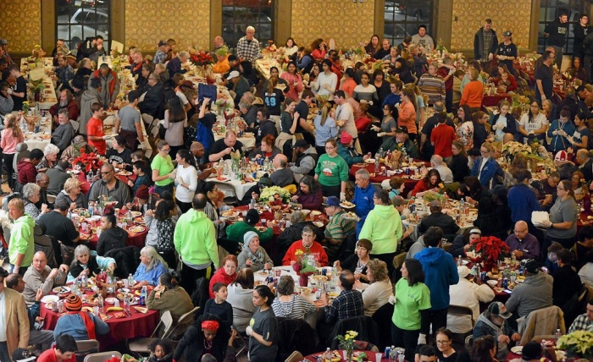
Who regulates this type of event?

Slide 12
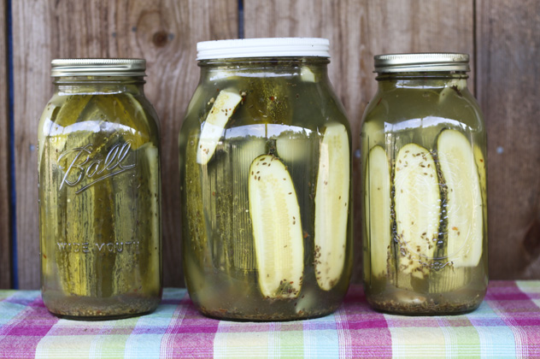
Who regulates this type of product?

Slide 13
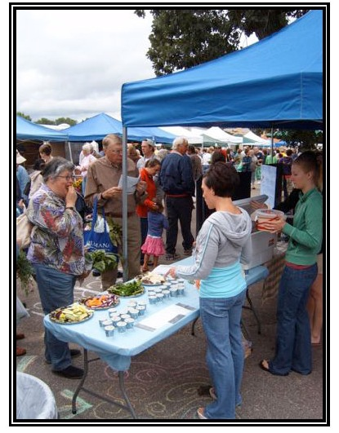
Who regulates this type of event?

Slide 14
Cooking School Exemption:
In June 2011, Senate Bill 346 / S.L. 2011-335 amended N.C.G.S. 130A-250 to exempt bona fide cooking schools from regulations governing the sanitation of establishments that prepare or serve food or drink to the public.
http://ehs.ncpublichealth.com/docs/position/CookingSchoolPositionStatement16-June2016-Final.pdf

Slide 15
Cooking schools which provide instruction, student food preparation, recipes, and/or curriculum are exempt from regulation by the local health department.
Because bona fide cooking schools are exempt, they cannot store, prepare, open, cook, or conduct unregulated activities in a permitted food establishment.
Cooking schools shall require a food establishment permit when the cooking school prepares or serves food or drink to the public for pay.

Slide 16
Temporary event exemption
Establishments (i) that are incorporated as nonprofit corporations …. that prepare or serve food or drink for pay no more frequently than once a month for a period not to exceed two consecutive days, including establishments permitted pursuant to this Part when preparing or serving food or drink at a location other than the permitted locations
http://ehs.ncpublichealth.com/faf/food/fd/docs/EnforcementManual/EnforcementStrategiesManual-Chapter6.pdf

Slide 17
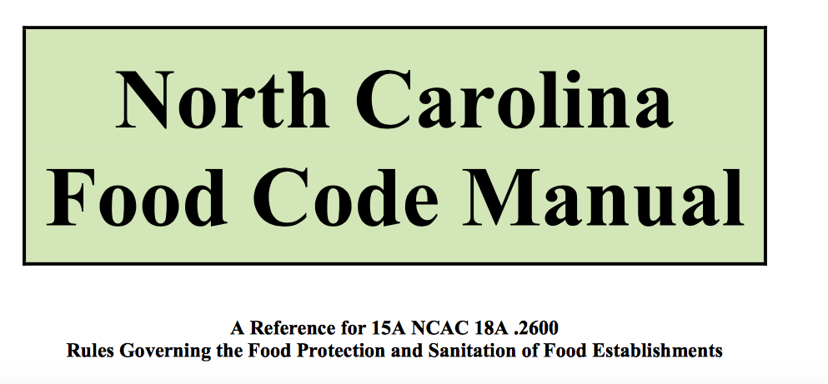

Slide 18
Overall best practices, even for exempt programming:
A NC Safe Plates instructor or Certified Food Protection Manager either is present at the event, or reviewing food handling/preparation plans prior to the event (whether that event is a workshop, class or fundraiser)

Slide 19
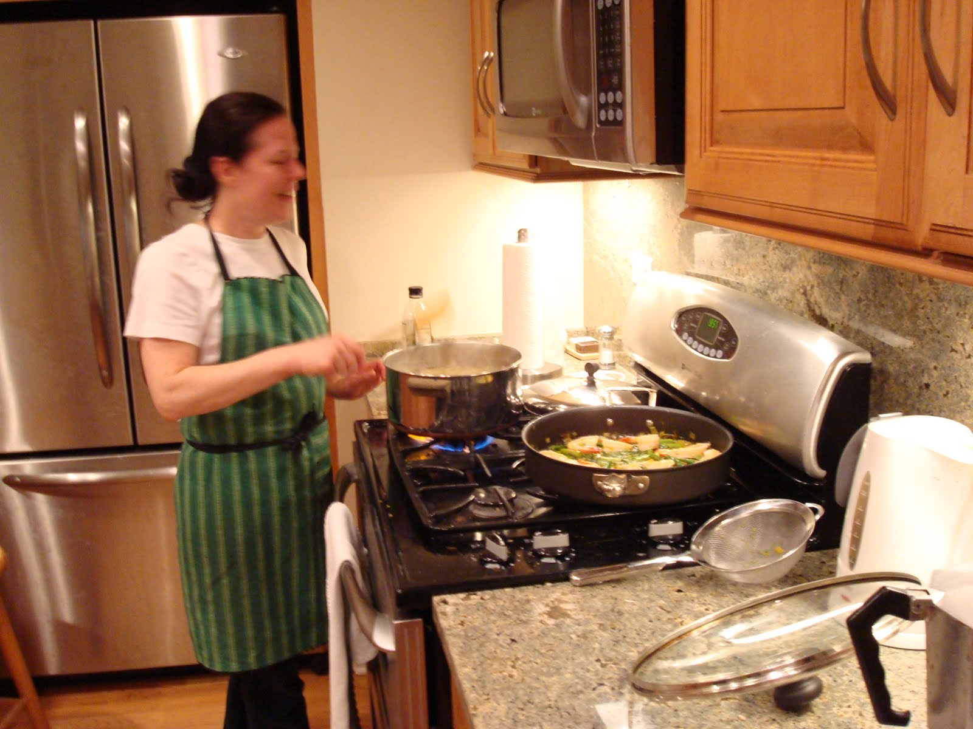
Best Practices
Foods that are prepared at home are low risk food processes/non-TCS foods….Or prepared by someone who is trained in safe food handling and has the equipment to verify safe temperatures.
That the individual has been told about food handler health policies and understands the responsibility.

Slide 20
Best Practices
Use advertising/announcement/flyers
that do not advertise that food products/canned products will be sold to participants

Slide 21
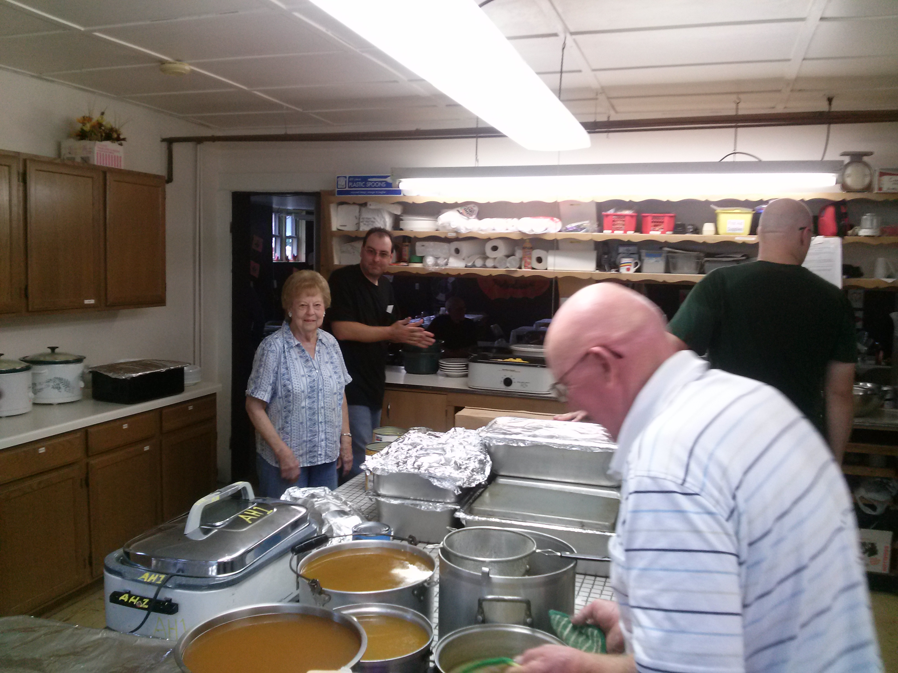
Best Practices
Take and record temperatures of Time Temperature Control For Safety foods (as per NC Food Code definition) to ensure proper storage, cooking and transport.

Slide 22
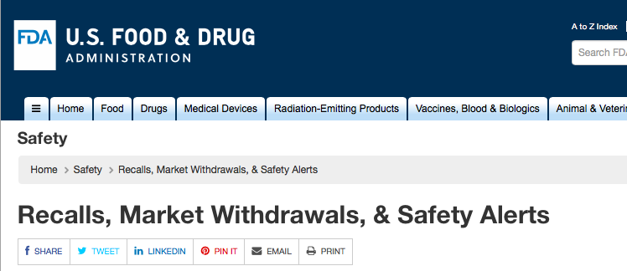
Best Practices
Track inputs and ingredients to enable follow-up with participants if products are recalled by suppliers

Slide 23
Best Practices
Use foods from approved and/or safe sources (as per NC Food Code definitions) in all events/classes

Slide 24
Clostridium botulinum
Lancaster, Ohio
One death and 24 illnesses
Linked to a church potluck
Canned potatoes in potato salad

Slide 25
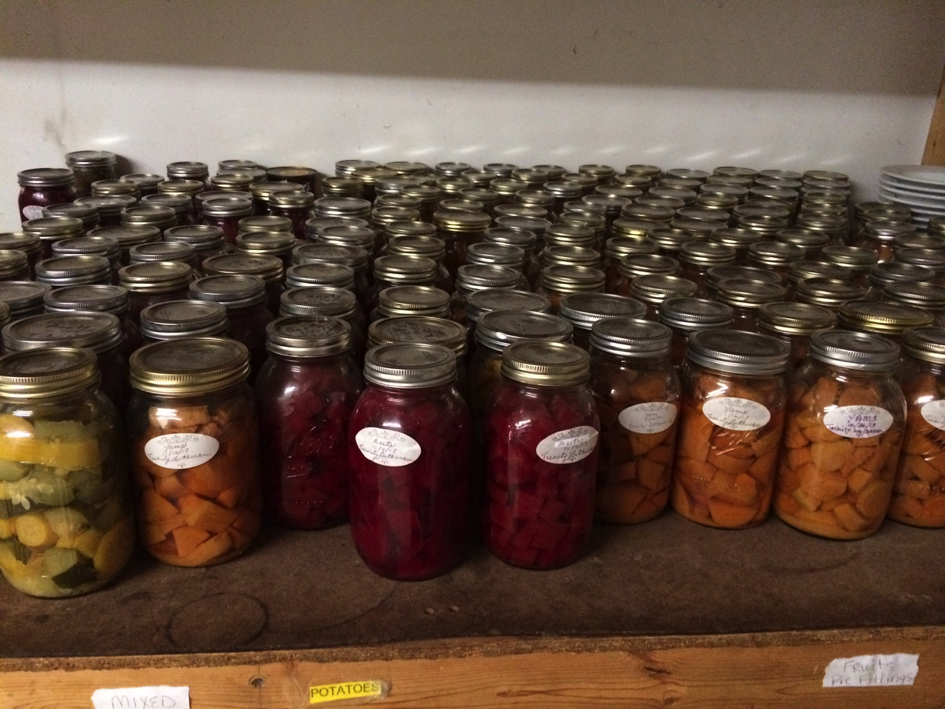
Taking items home after a canning class
Cooperative Extension provides evidence-based training and education on canning.
What processes are important for making a safe product?

Slide 26
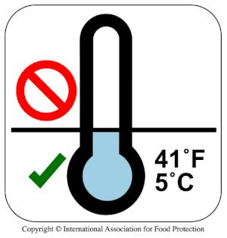
A must…
When participants in Extension canning classes take jars home, they should be told to refrigerate those jars, regardless of risk.
Affix a sticker to each jar

Slide 27
You are the expert in the room
If there is any doubt at all that preparation and all steps of the canning procedure were carried out just right, then the decision would be to treat that food as non processed (requiring refrigeration) even if it is allowed to thoroughly cool and seal before being taken home.

Slide 28
Evaluating risk –what could go wrong?
Low risk foods (for food safety)- high acid fruit jams and jellies
Medium-risk foods - acidified/fermented pickles
High-risk foods - Low acid canned foods such as green beans

Slide 29
Insurance and liability
For more information on Cooperative Extension insurance related to food programming please refer to Defense of State Employees and Insurance (https://generalcounsel.ncsu.edu/legal-topics/lawsuits-and-litigation/defense-of-state-employees-and-insurance/)

